Slide 1
Terraform All The Things
Security As Code
Brian Bush, CISSP | Security Architect

Slide 2
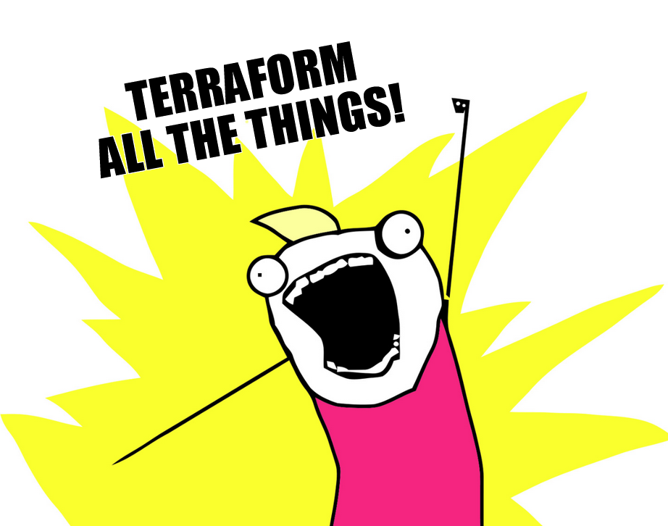


Brian Bush
26+ years in IT & Security
Newly back at UTHealth Houston
3y leading a DevSecOps team while away...
brian.m.bush@uth.tmc.edu
https://github.com/bbush-uthealth/

Slide 3




Infrastructure As Code [IaC]
Notes:
Terraform
Pulumi
Opentofu (opensource fork of Terraform)
AWS Cloudformation
(Ansible, not represented here)

Slide 4
Why IaC?
Consistence
Collaboration
Documentation
Security & Compliance
Scalability
Just Say Yes

Slide 5
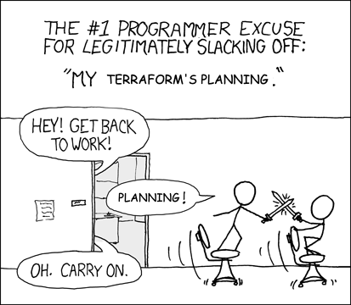
Terraform
Define resources
Create plan
Wait...
Apply infrastructure
Many providers available

Slide 6
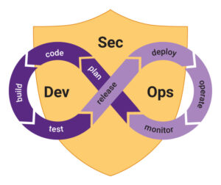
CI/CD & DevSecOps
Shift Left
DAST
SAST
Coding Standards
Policy As Code
Cultural Shift

Slide 7
IaC + CI/CD = Security As Code
Consistency & Reproducibility
Automated Compliance
Rapid Deployment
Immutable Infrastructure (and Security Controls)
Automated Testing & Validation
Disaster Recovery & Resilience

Slide 8
Resources
Infrastructure-As-Code
Dev<Sec>Ops – CI/CD
Terraform Documentation
IaC Intro
DevSecOps Fundamentals Guidebook: - DoD CIO
Awesome DevSecOps Repo

Slide 9


Slide 10
Questions?
Brian Bush
brian.m.bush@uth.tmc.edu
https://github.com/bbush-uthealth/

